Slide 1
Sample Case Studies of COVID-19 in Pregnancy

Slide 2
Case #1
33 yo G2P1 at 29w GA
Presents with temp of 38ºC, dry cough, shivering, general unwell for 9 days
NP swab for COVID-19 was taken
CXR: Left low lobe opacity
Should this patient be admitted? Based on what illness criteria?
What bloodwork should be ordered?
Where should she be admitted?
Is there a role for enoxaparin?
Is there a role for celestone?
If she is COVID +, when will she be recovered….will she need any post recovery swab?
Will she need any post recovery fetal follow up?

Slide 3
COVID-19 & Triage Assessment:
Patient presents to triage with COVID symptoms AND/OR an OBS concern:
Criteria for discharge home from triage:
Stable vital signs (HR < 100, RR 15-20, temp < 38oC, O2 sat > 94% on RA)
No oxygen requirement
No shortness of breath or work of breathing
Suitable for phone call follow up (through Public Health)
No acute obstetrical concerns
No other concerning co-morbidities
COVID Indications for admission: (based on illness assessment +/- co-morbidity)
Shortness of breath (unable to walk across room, speak full sentence)
Cough with blood
Chest pain
S/S dehydration
Decreased level of consciousness
Oxygen saturation < 94%
CXR consistent with pneumonia (ground glass opacities)

Slide 4
COVID-19 & Investigations:
Admission Investigations:
Baseline at admission, repeat as indicated
COVID NP swab
Routine bloodwork: lytes, creatinine, lactate
Prognostic bloodwork: CBC, PT, PTT, CRP, LDH, ferritin, fibrinogen, d-dimer (not to be used to detect risk of VTE as in non-pregnant population)
Lactate, Venous blood gas (if abnormal proceed to arterial blood gas)
BNP, troponin… if any concern for cardiac involvement
Urine PCR , uric acid +/- PLGF – if any concern for PET
Cultures: any concern for co-infections
ECG
CXR
2D ECHO (maternal) if severe illness/ICU admission/underlying cardiac condition
** if known cardiac disease consult with Cardiology to determine if should get an ECHO
CT scan only if clinically indicated (rule out pulmonary embolism)
* Consultation with ID , OB Medicine and ACCESS (ICU)

Slide 5
COVID-19 Admission and Surveillance:
Location depends on the local facility: Antenatal ward in level III centre Medicine ward in community setting
Surveillance & Warning signs
Vitals with O2 saturation q4h- if requiring oxygen support increase vitals to q hourly with 1:1 RN care
If requires: New use of oxygen support ** WARNING SIGN OF RESPIRATORY DETERIORATION: COVID SPECIFIC
RR increases despite normal O2 saturation
Increasing amount of oxygen to maintain saturation >94%
- Warning signs of maternal deterioration
Increased O2 demands by 50% over 1-2h
O2 sat < 94% despite O2 support
>4.0L O2 by facemask
Valid & Accurate & Applicable For Maternal Illness Assessment
High rate of detection (sensitive; true positive)
High negative predictive rate (specific; true negative)
Low rate of false positive (alert fatigue)
Tailored to the clinic setting, patient population
MEOWS: Maternal Early Obstetrical Warning Score
2 yellow or 1 red alert triggers MD evaluation

Slide 6
COVID-19 & Antenatal Management:
Role for thromboprophylaxis:
Any pregnant patient admitted to hospital for any indication is at risk for VTE
In COVID- “hypercoagulable” state
In GIM population, use of enoxaparin decreased mortality in patients with COVID severe illness
Recommend: VTE prophylaxis for pregnant patients admitted with moderate to severe disease COVID
- duration depends on clinical scenario
ie: moderate disease & delivered by C/S in patient with elevated BMI: duration based on OB recommendations
moderate disease admitted for COVID care & no other co-morbidities: duration of admission
Role for Celestone:
Corticosteroid Guidance for Pregnancy during COVID-19 Pandemic
Jennifer Jury McIntosh, DO, MD DOI https://doi.org/ 10.1055/s-0040-1709684.
lowest quality of evidence... authors opinion...
leap from high dose/duration in ICU patient
SUPPORT THE USE OF CELESTONE IF AN IDENTIFIED RISK FOR PRETERM BIRTH

Slide 7
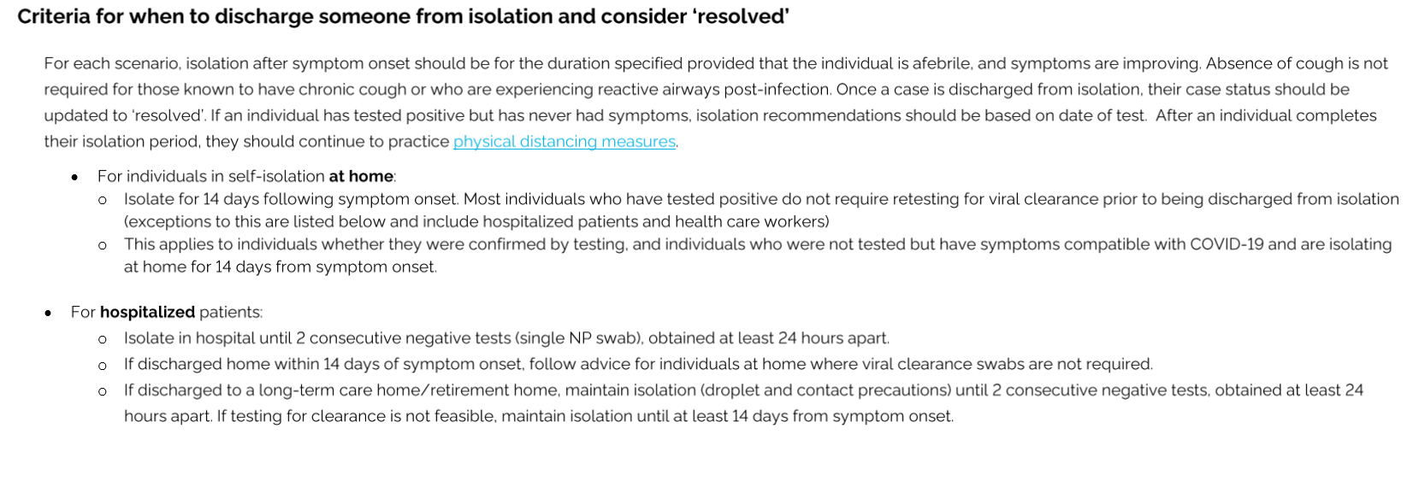
COVID-19 Recovery Algorithm

Slide 8
COVID-19 Recovery Algorithm
1. COVID diagnosis confirmed. Stays as an outpatient. Performs 14d self-isolation. Now has no symptoms consider COVID recovered. Does not need a swab for "test of cure". Can come back into medical system as COVID recovered/not infectious/negative.
2. COVID diagnosis confirmed, admitted for COVID support but then discharged before the 14d completed. Complete 14d self-isolation. Now has no symptoms, consider COVID recovered. Does not need a swab for "test of cure". Can come back into medical system as COVID recovered/not infectious/negative.
3. COVID diagnosis confirmed, admitted for COVID support and/or OB indication and is NOT discharged. At day 14 and with no symptoms we should perform 2 sets of NP swabs separated by 24h- both need to be negative and then she will be clear and released from droplet precaution (as per IPAC at MSH) Then she will be treated by us as COVID recovered/not infectious/negative.
*** If still antepartum: Ongoing fetal surveillance within 14d of discharge: BPP with Doppler and EFW

Slide 9
Case #2
40 yo G2P1 at 27w GA
Works in seniors home
Presents with 4d Hx of cough, malaise, fever
PMHx: Sickle cell disease (Rx with exchange transfusion; no VOC in pregnancy)
? Does she have COVID
? How do you make the diagnosis
? Should she be admitted
? Should she have antibiotics
? What are the maternal warning signs of deterioration
? What are the indications for ICU admission
? Should she be delivered

Slide 10
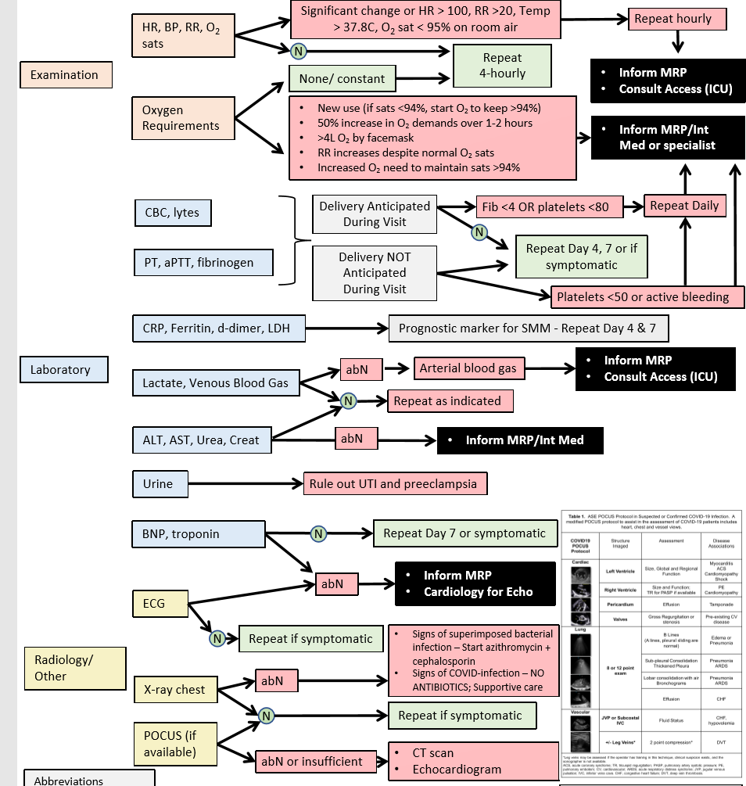
Inpatient care algorithm
Key Points:
Dx made by NP swab
CXR and bloodwork defines Dx severity
Additional tests based on co-morbidity
Treatment is supportive
* no ABX unless superimposed infection
5. Warning signs as per any @risk OB patient
* COVID specific respiratory signs

Slide 11
Delivery Considerations with COVID-19
COVID-19 infection is NOT a direct indication for delivery
Decision to deliver is individualized based on maternal & fetal status, GA
Principles:
If < 28w GA & can maintain mechanical ventilation: Ext Mx ….. risk of prematurity > risk of IUFD
If <28w GA & can NOT maintain mechanical ventilation…. ? Would delivery improve ventilation status
If > 28w GA & can maintain mechanical ventilation …. Consider delivery if signs of non-reassuring fetal status*
If >28 w GA & CAN NOT maintain mechanical ventilation: …. Consider delivery to manage ventilation **
* Fetal monitoring will be abnormal: tachycardia, minimal variability… decide frequency & what criteria to act upon
** NOT to improve maternal disease process, not to alter fetal/neonatal outcome, but to facilitate the ventilation
*** if delivering < 34w GA, give MgSO4 4g bolus before delivery- over 1 hour to limit maternal respiratory depression

Slide 12
Case #3
38yo 38wGA
Admitted for IOL: DM type II (poor control HbA1c 11%); Intrahepatic cholestasis of pregnancy, BMI 48
In labor, develops fever 38.8ºC….
Is this patient a PUI?
What steps should be taken?
Difficult to pick up FHR ? can FSE be applied
FHR is abnormal at 9cm…. ? can a scalp lactate be taken to confirm fetal well-being
Decision to proceed to C/S:
? what should the team DON
? where will the team DOFF
6. Newborn management
? Should we do delayed cord clamping
? Should she breastfeed
7. Does she need ppVTE prophylaxis

Slide 13
Key Points for Fever in Labor
Temperature >37.8oC
Give 500 cc fluid bolus (takes 30 min). DO NOT GIVE TYELENOL DURING THIS TIME
Repeat temperature 30 min after bolus completed
If still >37.8 (or any other symptoms) ….
Patient is now a PUI
NP swab for COVID
Initiate Droplet /Contact Precautions
IF > 38ºC … initiate chorioamnionitis workup and treatment … Blood cultures, Tyelenol, Broad spectrum ABX
After birth- Neonate also a PUI: perform NP swab
** Note: if using Misoprostil use for term IOL:
- 25-50 μg dose for IOL will not give maternal temperature

Slide 14
COVID-19 and Intrapartum Management: Key Points
Regardless of GA and disease severity: recommend hospital birth
Regardless of GA: CEFM based on case reports of fetal compromise in women with COVID-19 diagnosis (8/18 – 44% incidence)
If mild symptoms: Maternal vital signs (HR, BP, RR, O2 sat) q 2h.
If moderate symptoms: Maternal vital signs (HR, BP, RR, O2 sat) q 1h. Oxygen to keep O2 sat >94%
Hourly fluid status to avoid fluid overload (affects ventilation, work of breathing)
No hydrotherapy in labor/birth (risk of virus in feces? Infectious)
Encourage epidural anesthesia: minimize risk for GA
No evidence of virus in vaginal secretions/amniotic fluid: use Fetal Scalp Electrode and Scalp lactate sampling as per OB indications
No use of nitrous oxide for pain management (potential aersolization)
No indication for C/S unless to improve maternal resuscitation efforts
Emergent C/S for OB indications not because of COVID diagnosis
Elective C/S should not be delayed based on COVID diagnosis unless need for maternal stabilization.
COVID diagnosis is not an indication for IOL; diagnosis of COVID is not a reason to delay an indication/urgent IOL unless need for maternal stabilization.
Consideration: If SOB, maternal exhaustion or increasing hypoxia: may use assisted vaginal birth to shorten the second stage

Slide 15
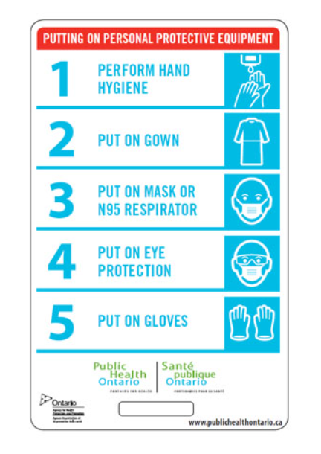
COVID: Donning and Doffing PPE:
DONNING PROCESS
This order suggested by Public Health does not account for the need for the surgical scrub for a C/S
This is a series of videos to guide OBs for DON and DOFF based on our unique patient interactions. This videos are based at Sinai Health System but do provide guidance for principles
Remember to DON outside the patient room/OR: in a clean space
If have a negative pressure room: the anteroom considered contaminated –
Don outside the room/OR

Slide 16
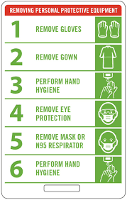
COVID: Donning and Doffing PPE:
DOFFING PROCESS
This order suggested by Public Health does not account for the need for the extra protective gear an OB would wear at a delivery
Principle of Doffing: dirtiest to cleanest
After a delivery:
Removes shoe covers
May consider to untie dirty gown with gloves on and then remove gown – gloves often pull off with the gown
Remember to DOFF inside the patient room/OR: EXCEPT MASK
DOFF Mask outside the patient room/OR
* If have negative pressure room DOFF all PPE in the anteroom

Slide 17
Key Points for Newborn to COVID +/PUI mom:
Based on: No evidence of virus in cord blood
Fetus was exposed to cord blood
Limited evidence of vertical transmission
Support breastfeeding*
Support skin to skin
Any direct baby care
* https://www.cps.ca/en/documents/position/breastfeeding-when-mothers-have-suspected-or-proven-covid-19
SUPPPORT DELAYED CORD CLAMPING
Mother to wear mask

Slide 18
COVID-19 & Postpartum Thromboprophylaxis:
Recommend:
OB indications for VTE prophylaxis
If no OB indications:
a. mild COVID disease – not required
b. moderate & severe disease- recommend as shown to decreased mortality in GIM patients

Slide 19
Case #4
33 yo G1P0 at 39w5d
Uncomplicated pregnancy followed by family practice
Presents to hospital with decreased FM
As part of OTAS assessment, triage RN places FHR monitor- FHR 70-80 BPM, confirmed against maternal HR 110 bpm ………. RN calls the OBSTERICAL EMERGENCY CODE
Is this patient a PUI?
Do we need to use PPE to assess the patient?
Once in OR, FHR still low….For stat C/S with plan for GA ? Does anyone require an N95 Mask

Slide 20
UNIVERSAL PRECAUTIONS FOR ANY NON-COVID BIRTH:
This is the Universal standard of Personal Protection Equipment at ANY Birth: not COVID +/PUI !!!
Goal is to protect against any pathogen contamination at a birth:
SHOES COVERS
WATER IMPERMEABLE GOWN
HAT (MAY USE OWN FABRIC CAP)
MASK
EYE PROTECTION (MAY USE OWN GOGGLES)
STERILE GLOVES
In the OR at a C/S, the glove and gowns will be donned using sterile technique after the scrub
NOTE:

Slide 21
PPE at an AGMP:
Procedures for which an N95 Mask should be worn by the anesthesia team

Slide 22
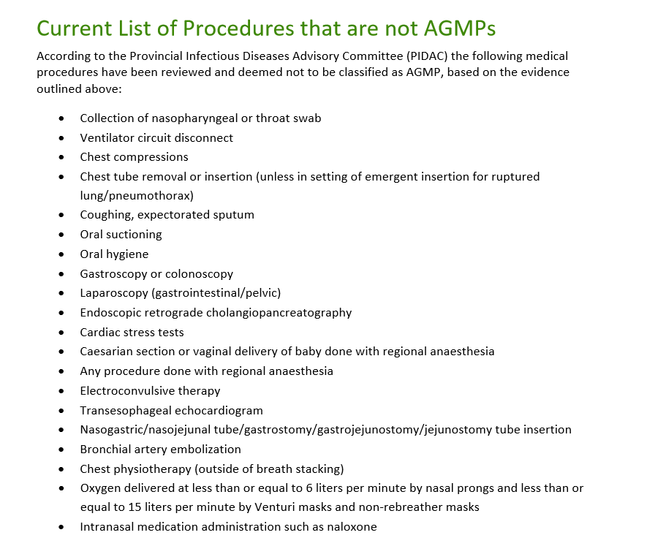
Public Health Ontario 2020

Slide 23
Case #5
32yo G1P0 at 27w GA
Presents to triage with meconium stained AFV after ? ROM, no contractions
In triage: No FHR detected. Consult OB: confirm diagnosis of IUFD
? how should labor be induced
? in labor develops fever: is this patient now a PUI

Slide 24
Key Points for TOP: Antenatal Unit or L&D
Patient is screened at hospital entry &
on admission to unit (with maternal temp check)
Screen negative (asymptomatic)
Proceed to IOL
1st dose of misoprostil with Tyelenol (1g) po
Dose misoprostil q 4h
Dose Tyelenol q6h (standing, regardless of maternal temp)
If temp > 37.8oC:
bolus 500cc over 30 min
Recheck temp 30 min after bolus complete
If remains >37.8oC… patient is now a PUI
NP swab and Droplet/Contact Precautions
Screen positive (symptomatic).. Patient is a PUI
NP Swab and Droplet/ Contact Precaution
1st dose of misoprostil + Tyelenol (1g) po
Dose misoprostil q 4h
Dose Tyelenol q6h (standing, regardless of maternal temp)
* Can substitute ASA (325mg) if allergy

Slide 25
Case #6
32 yo G2P1 at 33w GA
GDM insulin; no BPP yet in pregnancy
Telephone pre-screen before booked OB visit: runny nose
? What should you do
? NP swab positive for COVID
? You call her for virtual OB visit and to discuss COVID diagnosis in pregnancy
a. does she need to be admitted
b. when will she be COVID recovered
c. what is the impact on her baby

Slide 26
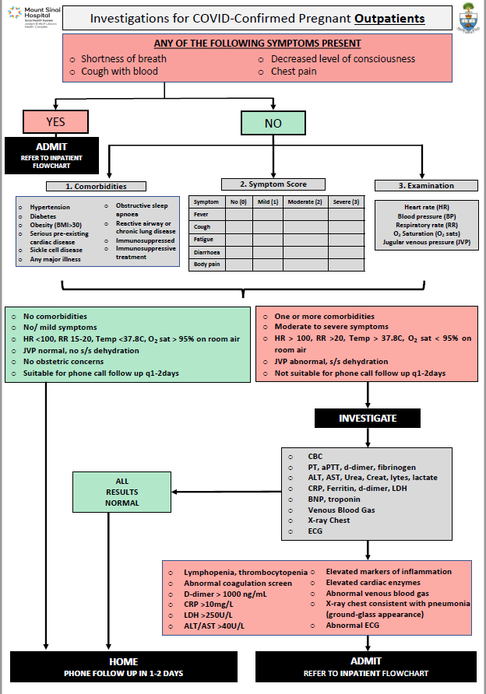
Outpatient screening algorithm
Key Points:
Screen positive patient needs an NP swab
To guide admission use:
illness criteria
co-morbidities
physical exam
investigations
3. Ensure patient is reliable /safe for
telephone F/U
4. Review warning signs with patient

Slide 27
COVID-19 and Pregnancy Key Points for Patients:
- Pregnant patients affected by COVID-19 make full recovery
15-20% develop a moderate to severe illness (2 case reports of maternal death; social media reports …)
No data to suggest increased risk of T1/T2 SA or teratogenicity
Limited evidence suggest vertical transmission is possible: to date babies born to COVID + moms have been well
Limited evidence suggests no increased risk of spontaneous preterm birth (labor)
Several cases of preterm birth: indicated for maternal health concerns OR fetal health concerns.
No data to suggest increased risk of IUFD
Based on data from SARS and MERS and other respiratory infection in pregnancy:
- minimal effect on long-term fetal growth/wellbeing
- suggest F/U OB scan once recovered

Slide 28
Case #7
32 yo G2P1 at 39w GA
Presents with UC q 3min, ROM for clear fluid, GBS negative
OBHx: diagnosed with COVID at 31w GA
? Any special precautions
? What will you wear at the delivery
? Are there any special tests
? Can she BF, skin to skin

Slide 29
Having a baby after COVID infection !
In the current state:
Screening at hospital entry
Screened with maternal temp in OB triage / labor
Treat as any screen negative patient
No “special precautions” for Labor & Delivery unless indicated by screening
5. Use universal precautions with the delivery:
OB provider: surgical mask, hat, eye protection, gloves and gown, shoe covers
Anesthesia: surgical mask, eye protection, gloves, gown and N95 mask if she requires intubation
RN: surgical mask, hat, eye protection, gloves and gown, shoe covers
6. Baby will NOT have an NP swab.
7. Mother & partner will NOT mask when having contact with baby (Skin to skin, BF...).

