Slide 1
The ‘cephalies’: macro- and micro-
(macren- and micren-)
Ants Toi
Medical imaging
Mt. Sinai Hospital
University of Toronto
Ants.toi@sinaihealthsystem.ca
SOON Estimated Fetal Weight Panel
2019-11-12b
Notes:
Updated: 2019-11-11 –edited, compactedSOON
-10: Vermont and drive

Slide 2


Slide 3
The size issue
Discordant head size for age is a finding, not a disease.
Increasing discordance ➔ increasing risk of:
  Dysfunction
  Abnormal brain development
  Chromosomal abnormality
Basic question:
When are you different enough to warrant further evaluation?

Slide 4
Microcephaly

Slide 5
Associated conditions:
Microcephaly > 700 syndromes
Macrocephaly > 200 syndromes
Pirozzi. Dialog in Clin Neurosci. 2018;20:267

Slide 6
Issues
Which nomograms?
When to suspect and refer for expert investigation and counseling?
If an isolated finding and all tests are negative, when to diagnose primary microcephaly?

Slide 7
Microcephaly definitions:
WHO (newborns)
Zika initiated new interest in microcephaly,
And differing diagnostic tools that could be applied worldwide

Slide 8
Microcephaly definitions and Dx:
WHO newborns
MC is a neurological condition in which HC is smaller than expected for gestational age and sex and may be associated with mental retardation.
MC: HC < -2SD measured in first 24 hr of life.
Severe MC: HC < 3SD
  Intergrowth-21 Size at Birth standards preferred for premature and post-term when gestation age known.
HC to body size disproportions proposed but not defined to date
Identification by experienced health professionals
Quinto. J Tropical Pediatrics. 2017;63:495
WHO/ZIKA/MOC/16.3/Rev3 (2016) accessed 2019-10-21
Notes:
These definitions are meant to apply world wide, including areas with limited means. In these cases only diagnosis is: Identification by experienced health professionals

Slide 9
Other classifications
  Primary – prenatal (most proportional, 64%)
  Secondary – postnatal
  Proportional – HC, length, weight all < 3rd centile
  Disproportional – HC < 3SD, length +/- weight > 3rd centile.
Von der Hagen. Dev Med Child Neurol. 2014;56(8):732
(Good reference for diverse etiologies)

Slide 10
Causes of primary MC
Short list of conditions where head/brain growth fails.
Von der Hagen. Dev Med Child Neurol. 2014;56(8):732
(Good reference for diverse etiologies)

Slide 11
Causes of MC in 680 children
Unknown 41%
Genetic 29%
Perinatal injury 27%
(infection, teratogen)
Craniosynostosis 2%
Von der Hagen. Dev Med Child Neurol. 2014;56(8):732
(Good reference for diverse etiologies)

Slide 12
Outcomes with microcephaly
Mental retardation^{1,2}
  -2 SD to -3 SD 11%
  -3 SD to -4SD 51%
  Smaller than -4 SD 100%
Worse outcomes if additional abnormalities
1. Dolk. Dev Med Child Neurol. 1991
2. Stoler-Poria,,Malinger. UOG. 2010

Slide 13
Microcephaly definition: SOGC,SMFM
No standardized definition. In pediatric populations, defined as HC below 3SD for age, sex and ethnicity.
    HC nomograms not specified: Had84, Had87, Had91, Chervenak98¹
In prenatal population:
SOGC
  < 2nd(sic) centile (= -2.05 SD)
  3 SD³ (“preferred by imaging specialists, endorsed by SMFM”)
1. Butt. JOGC.2014;36:171. Determination of Gestation age
2. De Bie. JOGC Committee Opinion, No. 380. JOGC 2019(June);41:855.
3. Chervenak. AJOG. 1884:149:512
4. Gelber,,Chervenak. J Perinat Med 2017;45:167
SMFM Committee. AJOG. 2016;214:B2-4
Notes:
Radiology. 1984 Aug;152(2):497-501. Estimating fetal age: computer-assisted analysis of multiple fetal growth parameters. Hadlock FP, Deter RL, Harrist RB, Park SK. Regression models for predicting menstrual age based on real-time sonographic measurements of four fetal parameters (biparietal diameter, head circumference, abdominal circumference, and femur length), used alone and in combination, were developed in a cross-sectional study of 361 fetuses between 14 and 42 menstrual weeks. The head circumference and femur length were the strongest individual predictors of age. A number of combinations of fetal parameters, including the combination of head circumference and femur length, provided age estimates that were significantly better (p = 0.05) than those using any single parameter alone. It was also demonstrated that simply averaging individual age estimates in a given case could provide results that were not significantly different from those obtained by using the same parameters in a complex regression equation. The advantages and potential pitfalls of this system of fetal dating are discussed.
Am J Obstet Gynecol. 1987 Apr;156(4):955-7. Estimating fetal age using multiple parameters: a prospective evaluation in a racially mixed population. Hadlock FP, Harrist RB, Shah YP, King DE, Park SK, Sharman RS. This study was designed to evaluate the accuracy of regression models for menstrual age prediction using single versus multiple fetal ultrasonographic measurements (biparietal diameter, head circumference, abdominal circumference, and femur length). The models tested had been previously developed from a study of middle-class white patients in a private hospital. The current study population consisted of 300 indigent black and Hispanic patients seen in a county hospital. This study demonstrated prospectively that the use of multiple parameters in estimating fetal age offers a significant advantage over any single parameter used alone and that the regression equations developed from a middle-class white population appear to be applicable to fetuses from a population with different socioeconomic and racial characteristics.
J Ultrasound Med. 1991 Oct;10(10):557-61. How accurate is second trimester fetal dating? Hadlock FP(1), Harrist RB, Martinez-Poyer J. Author information: (1)Department of Radiology, Baylor College of Medicine, Houston, Texas 77030. Comment in J Ultrasound Med. 1992 May;11(5):251-2. In this study, the Hadlock models for fetal dating using single and multiple parameters were tested retrospectively in 1770 chromosomally normal singleton fetuses in the second trimester (14 to 21 weeks of fetal development). The 95% confidence interval using measurements of the fetal head and femur individually was approximately +/- 1 week, which is comparable to the results of recently published dating models from other centers designed specifically for use during this time frame. The use of multiple-parameter models results in statistically significant improvement in prediction of age, in terms of both random error and maximum observed errors. We conclude that these models, developed for dating between 14 and 42 weeks of fetal development, provide highly accurate estimates of fetal age in the second trimester of pregnancy.
Am J Obstet Gynecol. 1998 Apr;178(4):678-87. How accurate is fetal biometry in the assessment of fetal age? Chervenak FA(1), Skupski DW, Romero R, Myers MK, Smith-Levitin M, Rosenwaks Z, Thaler HT. Author information: (1)Department of Obstetrics and Gynecology, The New York Hospital-Cornell Medical Center, New York 10021, USA. OBJECTIVE: The purpose of the study was to assess the accuracy of fetal biometry in the midtrimester of pregnancy in the assignment of fetal age. STUDY DESIGN: A total of 152 singleton, 67 twin, and 19 triplet gestations resulting from in vitro fertilization with ultrasonographic fetal biometry from 14 to 22 weeks made up the study population. A gestational age prediction equation was derived from singletons with the use of stepwise linear regression. This equation was compared with 38 previously published equations and then applied to the twin and triplet populations. RESULTS: Head circumference was the best predictor of gestational age (random error [SD] 3.77 days). Addition of abdominal circumference and femur length to head circumference improved the accuracy of the dating equation (random error 3.35 days). Most dating formulas had systematic errors of <1 week. The systematic error was -0.32 day for averaging the singleton-based predictions for twins and -1.26 days for triplets. CONCLUSIONS: Gestational age assessment with the use of fetal biometry from 14 to 22 weeks is accurate for singleton, twin, and triplet gestations.

Slide 14
Microcephaly definition: SOGC,SMFM
No standardized definition. In pediatric populations, defined as HC below 3SD for age, sex and ethnicity.
  HC nomograms not specified: Had84, Had87, Had91, Chervenak98¹
In prenatal population:
SOGC
  < 2nd(sic) centile (= -2.05 SD)
  3 SD³ (“preferred by imaging specialists, endorsed by SMFM”)
SMFM (Old Chervenak 1984 HC table³; not newer Gelber,,Chervenak 2017⁴)
  -2SD to -3SD -careful evaluation, follow up 3-4 wk
  -3 SD -microcephaly
  < -5 SD -certain pathologic microcephaly
1. Butt. JOGC.2014;36:171. Determination of Gestation age
2. De Bie. JOGC Committee Opinion, No. 380. JOGC 2019(June);41:855.
3. Chervenak. AJOG. 1884:149:512
4. Gelber,,Chervenak. J Perinat Med 2017;45:167
5. SMFM Committee. AJOG. 2016;214:B2-4
Notes:
Radiology. 1984 Aug;152(2):497-501. Estimating fetal age: computer-assisted analysis of multiple fetal growth parameters. Hadlock FP, Deter RL, Harrist RB, Park SK. Regression models for predicting menstrual age based on real-time sonographic measurements of four fetal parameters (biparietal diameter, head circumference, abdominal circumference, and femur length), used alone and in combination, were developed in a cross-sectional study of 361 fetuses between 14 and 42 menstrual weeks. The head circumference and femur length were the strongest individual predictors of age. A number of combinations of fetal parameters, including the combination of head circumference and femur length, provided age estimates that were significantly better (p = 0.05) than those using any single parameter alone. It was also demonstrated that simply averaging individual age estimates in a given case could provide results that were not significantly different from those obtained by using the same parameters in a complex regression equation. The advantages and potential pitfalls of this system of fetal dating are discussed.
Am J Obstet Gynecol. 1987 Apr;156(4):955-7. Estimating fetal age using multiple parameters: a prospective evaluation in a racially mixed population. Hadlock FP, Harrist RB, Shah YP, King DE, Park SK, Sharman RS. This study was designed to evaluate the accuracy of regression models for menstrual age prediction using single versus multiple fetal ultrasonographic measurements (biparietal diameter, head circumference, abdominal circumference, and femur length). The models tested had been previously developed from a study of middle-class white patients in a private hospital. The current study population consisted of 300 indigent black and Hispanic patients seen in a county hospital. This study demonstrated prospectively that the use of multiple parameters in estimating fetal age offers a significant advantage over any single parameter used alone and that the regression equations developed from a middle-class white population appear to be applicable to fetuses from a population with different socioeconomic and racial characteristics.
J Ultrasound Med. 1991 Oct;10(10):557-61. How accurate is second trimester fetal dating? Hadlock FP(1), Harrist RB, Martinez-Poyer J. Author information: (1)Department of Radiology, Baylor College of Medicine, Houston, Texas 77030. Comment in J Ultrasound Med. 1992 May;11(5):251-2. In this study, the Hadlock models for fetal dating using single and multiple parameters were tested retrospectively in 1770 chromosomally normal singleton fetuses in the second trimester (14 to 21 weeks of fetal development). The 95% confidence interval using measurements of the fetal head and femur individually was approximately +/- 1 week, which is comparable to the results of recently published dating models from other centers designed specifically for use during this time frame. The use of multiple-parameter models results in statistically significant improvement in prediction of age, in terms of both random error and maximum observed errors. We conclude that these models, developed for dating between 14 and 42 weeks of fetal development, provide highly accurate estimates of fetal age in the second trimester of pregnancy.
Am J Obstet Gynecol. 1998 Apr;178(4):678-87. How accurate is fetal biometry in the assessment of fetal age? Chervenak FA(1), Skupski DW, Romero R, Myers MK, Smith-Levitin M, Rosenwaks Z, Thaler HT. Author information: (1)Department of Obstetrics and Gynecology, The New York Hospital-Cornell Medical Center, New York 10021, USA. OBJECTIVE: The purpose of the study was to assess the accuracy of fetal biometry in the midtrimester of pregnancy in the assignment of fetal age. STUDY DESIGN: A total of 152 singleton, 67 twin, and 19 triplet gestations resulting from in vitro fertilization with ultrasonographic fetal biometry from 14 to 22 weeks made up the study population. A gestational age prediction equation was derived from singletons with the use of stepwise linear regression. This equation was compared with 38 previously published equations and then applied to the twin and triplet populations. RESULTS: Head circumference was the best predictor of gestational age (random error [SD] 3.77 days). Addition of abdominal circumference and femur length to head circumference improved the accuracy of the dating equation (random error 3.35 days). Most dating formulas had systematic errors of <1 week. The systematic error was -0.32 day for averaging the singleton-based predictions for twins and -1.26 days for triplets. CONCLUSIONS: Gestational age assessment with the use of fetal biometry from 14 to 22 weeks is accurate for singleton, twin, and triplet gestations.

Slide 15
Prenatal Thresholds: Guibaud
Use SD or Z-scores, not centiles.
-2SD Investigate and follow
-3SD Diagnose
Hadlock 82 is table quoted by
Guibaud in UOG 2016
Guibaud. UOG. 2016;48:16
Hadlock. Am J Roentgen. 1982;138:649
Stoler-Poria. UOG. 2010:36:154
Notes:
Guibaud L, Lacalm A. Diagnostic imaging tools to elucidate decreased cephalic biometry and fetal microcephaly: a systematic analysis of the central nervous system. Ultrasound Obstet Gynecol. 2016 Jul;48(1):16-25. doi: 10.1002/uog.15926. Review. PubMed PMID: 27015746.
Stoler-Poria. UOG. 2010:36:154 is Malinger’s group
Hadlock FP, Deter RL, Harrist RB, Park SK. AJR Am J Roentgenol. 1982 Apr;138(4):649-53. Fetal head circumference: relation to menstrual age. The relation between fetal head circumference and menstrual age was determined by cross-sectional analysis of 400 fetuses (15-41 weeks) examined with a linear array real-time (dynamic image) scanner using specifically defined methodology. Mathematical modeling of the data demonstrated that the head circumference growth curve is nonlinear, similar to the biparietal diameter growth curve. Both the linear quadratic (r2 = 98.3%) and linear cubic (r2 = 98.3%) functions could be considered the optimal model. Predicted head circumference values for the linear cubic function were comparable to established normal values on the basis of postnatal measurements at 25-40 weeks (mean difference, -0.94 mm; SD, 0.47 mm). Predicted menstrual age values (+/- 2 SD) associated with a given head circumference measurement were calculated and are presented in tabular form. The use of the head circumference measurement in predicting menstrual age, estimating fetal weight, and in detecting intrauterine growth retardation is discussed. DOI: 10.2214/ajr.138.4.649 PMID: 6978026 [Indexed for MEDLINE]

Slide 16
SOGC
SOG
De Bie. SOGC Committee Opinion, No. 380. JOGC 2019(June);41:855.
Notes:
Key message: I would have put focus on prenatal diagnosis and identify severe

Slide 17
Investigation/Management: SOGC
SOGC defines MC as <3SD but does not say when referral should occur.
Good practical approach when MIC suspected.
De Bie. SOGC Committee Opinion, No. 380. JOGC 2019(June);41:855.
Notes:
Key message: I would have put focus on prenatal diagnosis and identify severe

Slide 18
Investigation:
Von der Hagen. Dev Med Child Neurol. 2014;56(8):732
(Good reference for diverse etiologies)

Slide 19
Diagnostic imaging tools: Guibaud
Practical approach to imaging assessment if MIC suspected.
Criteria used by Guibaud
Guibaud. UOG. 2016;48:16
Hadlock. Am J Roent. 1982;138:649
Notes:
Guibaud L, Lacalm A. Diagnostic imaging tools to elucidate decreased cephalic biometry and fetal microcephaly: a systematic analysis of the central nervous system. Ultrasound Obstet Gynecol. 2016 Jul;48(1):16-25. doi: 10.1002/uog.15926. Review. PubMed PMID: 27015746.

Slide 20
Diagnostic imaging tools: Guibaud
Guibaud. UOG. 2016;48:16
Notes:
Guibaud L, Lacalm A. Diagnostic imaging tools to elucidate decreased cephalic biometry and fetal microcephaly: a systematic analysis of the central nervous system. Ultrasound Obstet Gynecol. 2016 Jul;48(1):16-25. doi: 10.1002/uog.15926. Review. PubMed PMID: 27015746.

Slide 21
Some problems in diagnosis
Differences between prenatal and postnatal biometry²
  Only 2 of 20 in utero MC² were microcephalic at birth^{3(charts?)}
  No adverse outcomes in -2 to -3 SD
Prenatal HC underestimates actual by 1.36 cm and error increases with gestational age.⁴
Variable time of presentation, usually late
Is it MC or IUGR?
  45% MC symmetrical IUGR, 55% small head, normal weight²
1. Dolk. Dev Med Child Neurol. 1991
2. Stoler-Poria,,Malinger. UOG. 2010
3. Kurmanavicius. Br J O&G 1999 –prenatal nomogram
4. Melamed. UOG 2011

Slide 22
Accuracy of US screening for prenatal MC with Zika (review)
Chibueze. Sci Rep. 2017 May 23;7(1):2310.
Notes:
1. Sci Rep. 2017 May 23;7(1):2310. doi: 10.1038/s41598-017-01991-y. Diagnostic Accuracy of Ultrasound Scanning for Prenatal Microcephaly in the context of Zika Virus Infection: A Systematic Review and Meta-analysis. Chibueze EC(1), Parsons AJQ(2), Lopes KDS(3), Yo T(3), Swa T(3)(4), Nagata C(5), Horita N(6), Morisaki N(7), Balogun OO(3), Dagvadorj A(3)(8), Ota E(3)(9), Mori R(3), Oladapo OT(10). Author information: (1)Department of Health Policy, National Center for Child Health and Development, Tokyo, Japan. ezinne.chibueze@gmail.com. (2)Department of Global Health Policy, Graduate School of Medicine, University of Tokyo, Tokyo, Japan. (3)Department of Health Policy, National Center for Child Health and Development, Tokyo, Japan. (4)Graduate School of Human Sciences, Osaka University, Osaka, Japan. (5)Department of Education for Clinical Research, National Center for Child Health and Development, Tokyo, Japan. (6)Pulmonology, Graduate School of Medicine, Yokohama City University, Yokohama, Japan. (7)Department of Social Medicine, National Center for Child Health and Development, Tokyo, Japan. (8)Department of Health Informatics, Kyoto University, Yoshida Konoe-cho, Syako-ku, Kyoto, Japan. (9)St. Luke's International University, Graduate school of Nursing, Global Health Nursing, Tokyo, Japan. (10)UNDP/UNFPA/UNICEF/WHO/World Bank Special Programme of Research, Development and Research Training in Human Reproduction (HRP), Department of Reproductive Health and Research World Health Organization, Geneva, Switzerland. To assess the accuracy of ultrasound measurements of fetal biometric parameters for prenatal diagnosis of microcephaly in the context of Zika virus (ZIKV) infection, we searched bibliographic databases for studies published until March 3rd, 2016. We extracted the numbers of true positives, false positives, true negatives, and false negatives and performed a meta-analysis to estimate group sensitivity and specificity. Predictive values for ZIKV-infected pregnancies were extrapolated from those obtained for pregnancies unrelated to ZIKV. Of 111 eligible full texts, nine studies met our inclusion criteria. Pooled estimates from two studies showed that at 3, 4 and 5 standard deviations (SDs) <mean, sensitivities were 84%, 68% and 58% for head circumference (HC); 76%, 58% and 58% for occipitofrontal diameter (OFD); and 94%, 85% and 59% for biparietal diameter (BPD). Specificities at 3, 4 and 5 SDs below the mean were 70%, 91% and 97% for HC; 84%, 97% and 97% for OFD; and 16%, 46% and 80% for BPD. No study including ZIKV-infected pregnant women was identified. OFD and HC were more consistent in specificity and sensitivity at lower thresholds compared to higher thresholds. Therefore, prenatal ultrasound appears more accurate in detecting the absence of microcephaly than its presence

Slide 23
Diagnostic dilemma
Deloison. Prenat Diag. 2012; 32:869

Slide 24
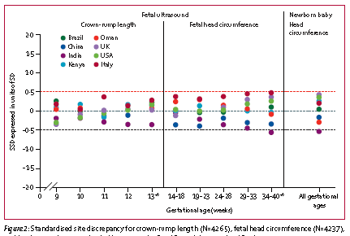

Prenatal inter-site variation in HC measurements in perfect conditions
Even under ‘perfect’ conditions of IG-21, there is variation in prenatal and postnatal HC assessment.
Villar. (Intergrowth-21). 2014; 2:781. Lancet: Diabetes-endocrinology

Slide 25
Choice of chart affects diagnosis of MC.
51 fetuses referred with HC < 5th centile (Had 84).
  n = 51
  HC < 5centile (Had84)
  Referred at 18-36 weeks
  normal anatomy on US and MRI. (No neonatal FU)
Different author’s nomograms have different ranges of normal.
Z – score | Chervenak 1984 | Hadlock 1984 | Gelber, Chervanak 2017 | Papageorghiou Intergrowth-21
Normal >2 | 42 (79%) | 25 (49%) | 29 (57%) | 32 (63%)
Poss. normal 2-3 | 8 | 16 | 17 | 14
MC <3 | 1 | 10 | 5 | 10
Sanapo. J Matern Fetal Neonatal Med. 2019 Oct 1:1-6. [Epub ahead of print])
Notes:
Sanapo L(1)(2), Herrera N(3), Cristante C(1), Bulas DI(4), Russo S(1), Schlatterer SD(1), du Plessis AJ(1)(5)(6), Mulkey SB(1)(5)(6).
J Matern Fetal Neonatal Med. 2019 Oct 1:1-6. doi: 10.1080/14767058.2019.1670163. [Epub ahead of print]
How prenatal head ultrasound reference ranges affect evaluation of possible fetal microcephaly.
Author information: (1)Division of Fetal and Transitional Medicine, Children's National Health System , Washington , DC , USA. (2)Department of Clinical Research & Leadership School of Medicine and Health Sciences, George Washington University , Washington , DC , USA. (3)Division of Biostatistics and Study Methodology, Children's National Health System , Washington , DC , USA. (4)Division of Diagnostic Imaging and Radiology, Children's National Health System , Washington , DC , USA. (5)Department of Pediatrics, George Washington University School of Medicine and Health Sciences , Washington , DC , USA. (6)Department of Neurology, George Washington University School of Medicine and Health Sciences , Washington , DC , USA. Objectives: Different fetal ultrasound (US) nomograms of the head circumference (HC) have been established; however, comparisons between the detection rates of microcephaly among US nomograms are few and inconsistent. We aimed to compare the prenatal diagnostic rate of fetal microcephaly (FM) among four widely used US nomograms of the fetal HC, when applied to the same group of fetuses. Methods: We retrospectively identified singleton pregnancies complicated by fetal HC < 5th percentile for gestational age (GA) by US, without other risk factors for FM and with normal fetal brain MRI. Raw values of HC by US were converted to z-scores using four nomograms (Chervenak = A, Hadlock = B, Gelber = C, Papageorghiou = D). Z-scores value of the HC were classified as normal, possible normal, or microcephaly if values were >-2, ≤ -2 and >-3, or ≤ -3, respectively and compared among the four nomograms. Results: Fifty one fetuses at a mean (±SD) GA of 28 (±4) weeks were included. The four nomograms resulted in different z-score values of the fetal HC for the same subject (p < .001) and none of them showed 100% agreement. Reference C and D showed the highest agreement in classifying subjects as normal, possible normal, or with microcephaly (simple Kappa = 0.8915, % agreement = 94.1%), while A and B had the lowest agreement (simple Kappa = 0.0977, % agreement = 51.0%). Conclusions: Despite the use of similar prenatal cutoff z-score values of the fetal HC, the four nomograms led to different diagnostic rates of FM. More consistent diagnostic criteria are therefore needed to define FM, especially in the absence of other risk factors for FM and normal fetal brain MRI, since the prenatal diagnosis can affect pregnancy management. DOI: 10.1080/14767058.2019.1670163 PMID: 3153350

Slide 26
SOON suggests using Hadlock 84 using head circumference for dating
This is the Head Circumference paper recommended by SOON.

Slide 27
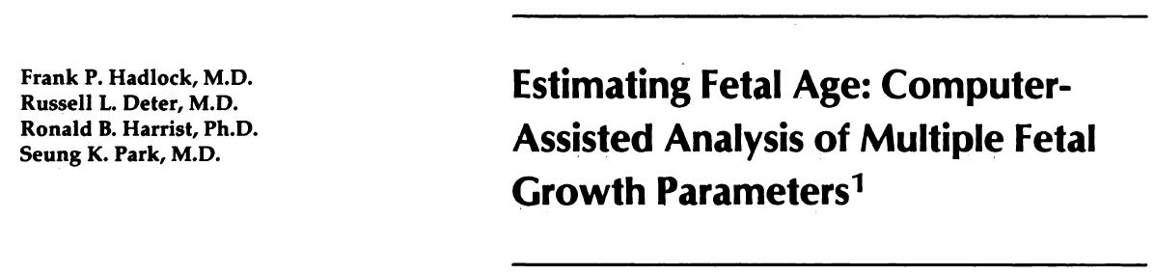
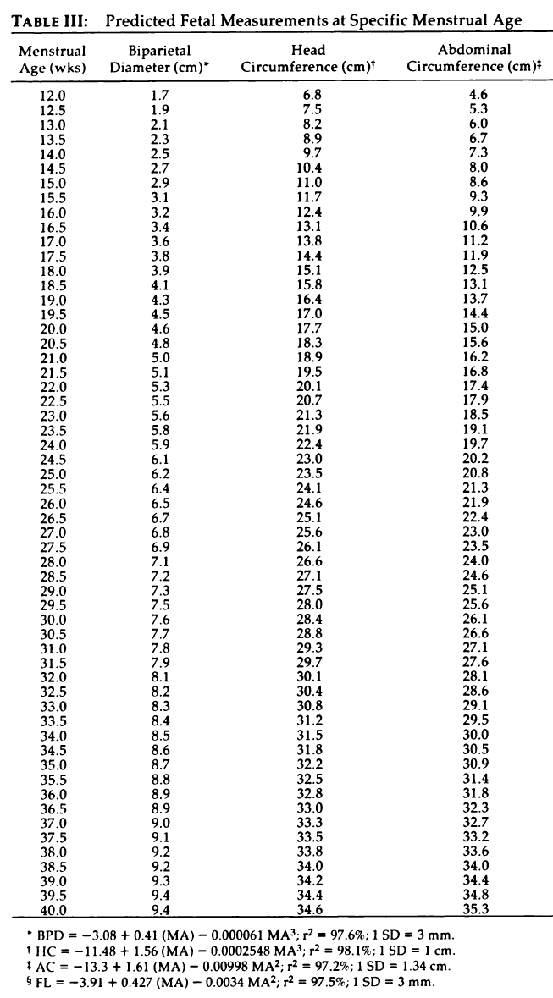
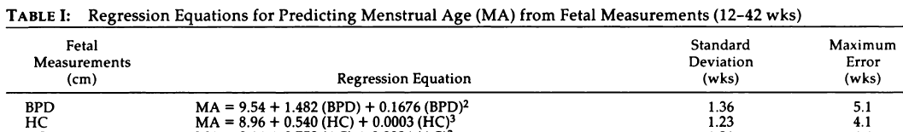
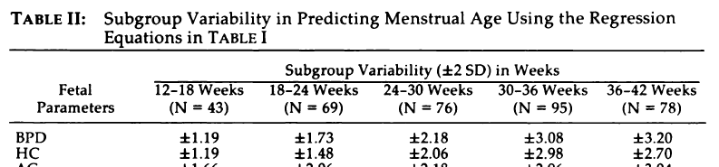
Radiology. 1984;152:497
Values in HC paper recommended by SOON:
Note:
-Age to expected HC is a chart
-HC to age is only an equation.

Slide 28
To quickly test if the HC to age and Age to HC values fit normal patients at Mount Sinai.
-sequential patients with normal scans.
For all ages:
HC predicted from menstrual age should match age calculated from HC measurement.
Measured HC should follow curve of predicted HC.
Difference between predicted and measured age should be 0.

Slide 29
Does age estimated from Hadlock 84 HC match age determined from CRL?
Predicted HC age matches measured HC. age.
MSH pts
All dated by CRL
All EFW normal
Notes:
From SOON biometry study: CRL age = CRLage2; HC age = HCage

Slide 30
Does CRL age predict HC at different ages?
Measured HC matches HC predicted from age
MSH pts
All dated by CRL
All EFW normal

Slide 31
Does how closely does H84 HC predicted age match true CRL age
True age closely matches age of HC measurement.
MSH pts
All dated by CRL
All EFW normal

Slide 32
All assessed HC nomograms have similar mean ages but with slight divergence after about 35 weeks.

Slide 33
…but -2SD boundaries are very different.
Notes:
Hadlock 82 – specific HC paper.
Gelber is Chervenak second paper.
SOGC biometry notes:
Hadlock 94 is only usable HC equation of the 4 listed by Butt
Hadlock 91. dating accuracy paper, no equations.
Chervenak 1998. dating accuracy paper. Only linear equations, no variations or SD
Hadlock 1987. Interracial accuracy paper.

Slide 34
Including those of the recommended nomograms, Had 84 and Chervenak 84

Slide 35
Chervenak vs Gelber tables for MC
Gelber 2017
Chervenak 1984
SOGC and SMFM have both accepted the 1984 chart as proposed by Chervenak.
2
Endorsed by SMFM and SOGC
1. Chervenak. Obstet Gyn. 1984;149;512
2. Gelber,,Chervenak. J Perinat Med. 2017;45:167

Slide 36
Hadlock 84 vs Chervenak 84, MSH pts

Slide 37
Work flow in US lab
Measure HC > estimate age
If age predicted by HC is small or large, you need to compare to expected HC for age – ie. DIFFERENT TABLE
Hadlock 84 has two different equations:
  MA = 8.96 + 0.540(HC) + 0.0003(HC)³ SD= 1.23 wk
  HC = -11.48 + 1.56(MA) – 0.0002548(MA)³ SD= 1 cm
For same HC the AGES are slightly different (<1 wk).

Slide 38
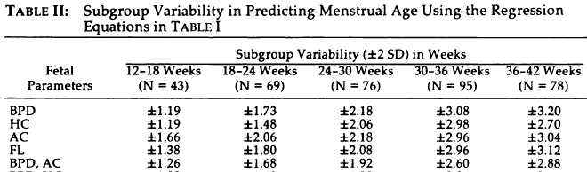
Steps in routine US evaluation
Establish gestational age!!!
Measure HC using Hadlock 84
If HC small consider MC, evaluate whole fetus
Set criteria for consultation with appropriate experts
  Typically HC < -2SD for gestational age using H82 or H84 (about 10% of age)
  Or outside 5 or 95 centiles
As expert, use Chervenak 1984 for SD (SOGC and SMFM)
Hadlock. Rad. 1984;152:497. Hadlock. Am J Roent. 1982;138:649. Chervenak. AJOG. 1984;149:512

Slide 39
Microcephaly: comments after presentation
Agreement on Hadlock 84 HC age and Chervenak 84 microceph charts.
Suggest expert referral for possible microcephaly when HC is smaller than -2SD on Chervenak 84 chart. (this is virtually the same as HC -3SD on Haldlock 84.
Typical workflow estimates age from HC (not HC from age).
For ease of practice, consider referral when:
  HC is 3 cm too small (3cm = 3SD)
  Or predicted age about 10% younger than expected
    eg. If at 32 weeks if head is 3.2 weeks younger (28.8 weeks size), consider expert referral.
  Both are virtually equivalent to Cher84 -2SD referral threshold.
  In any case, if in doubt, suggest considering referral.
At expert site, follow SOGC and SMFM guidelines.

Slide 40
Microcephaly: clues when to suspect
(detailed analysis of the 3cm and 10% age criteria)
Short cuts to referral point for possible Microcephaly, ie. Close to -2SD on Chervenak 84 chart
Calculate age when HC is 3 cm (ie 3SD) smaller than HC expected at that age
A | B | C | D | E | F | G | H | I | J |  | A | true fetal age
true age | expected | HC 3 cm | Age pred by | True-pred | percent | Cher84 | H84 age | True-pred | percent |  | B | expected HC at true age (A) from Had 84
 | HC at | smaller | 3cm smaller | age | pred/true | -2sd head | from C84 | age | pred/true |  | C | measured HC - 3SD (ie -3 cm)
 | true age | (=h4 3sd) | head | at -3SD | % | (cm) | head size | wks | % |  | D | age predicted from HC that is 3 cm too small
12 | 6.8 | 3.8 | 11.0 | 1.0 |  |  |  |  |  |  | E | true age - predicted age (A - D)
14 | 9.7 | 6.7 | 12.6 | 1.4 |  |  |  |  |  |  | F | percent difference between true and predicted age (F/A x100 percent)
16 | 12.4 | 9.4 | 14.3 | 1.7 | 11 |  |  |  |  |  | G | Cher 84 HC at -2SD
18 | 15.1 | 12.1 | 16.0 | 2.0 | 11 |  |  |  |  |  | H | Age predicted from G (ie. Cher84 -2SD HC)
20 | 17.7 | 14.7 | 17.8 | 2.2 | 11 | 14.5 | 17.7 | 2.3 | 11 |  | I | true age - C84 HC predicted age (A - H)
22 | 20.1 | 17.1 | 19.7 | 2.3 | 10 | 17 | 19.6 | 2.4 | 11 |  | J | percent difference between true and predicted age (J/A x100 percent)
24 | 22.4 | 19.4 | 21.6 | 2.4 | 10 | 19.1 | 21.4 | 2.6 | 11
26 | 24.6 | 21.6 | 23.6 | 2.4 | 9 | 21.2 | 23.3 | 2.7 | 11
28 | 26.6 | 23.6 | 25.6 | 2.4 | 8 | 23.2 | 25.2 | 2.8 | 10 |  | Note that (h84 -3SD) ages [E] and (Cher84 -2SD) ages [I] are similar
30 | 28.4 | 25.4 | 27.6 | 2.4 | 8 | 25.1 | 27.3 | 2.7 | 9 |  | Both are about 10% of the expected age (A)
32 | 30.1 | 27.1 | 29.5 | 2.5 | 8 | 26.9 | 29.3 | 2.7 | 8 |  | ie. if age prediction from h84 HC is about 10% smaller than true age,
34 | 31.5 | 28.5 | 31.3 | 2.7 | 8 | 28.2 | 30.9 | 3.1 | 9 |  |  | then Chervenak HC is close to -2SD, the microcaphalic range.
36 | 32.8 | 29.8 | 33.0 | 3.0 | 8 | 29.5 | 32.6 | 3.4 | 9 |  | Suggests pt should be referred for expert evaluation when:
38 | 33.8 | 30.8 | 34.4 | 3.6 | 10 | 30.5 | 33.9 | 4.1 | 11 |  |  | H84 HC is 3 cm below expected
40 | 34.6 | 31.6 | 35.5 | 4.5 | 11 | 31.3 | 35.1 | 4.9 | 12 |  |  | This is equivalent to saying estimated age is 10% smaller than expected.
Chervenak -2SD criterion is virtually the same as:
Head measurement 3 cm smaller than expected
HC age prediction 10% too young

Slide 41
Macrocephaly

Slide 42
Macrocephaly
Definition: HC > +2 SD or >98th centile
  No consensus during fetal life regarding biometry
  Megalencephaly = increased cerebral structures
    Big brain
    Enlarged subarachnoid spaces (benign external hydrocephalus)
  Macrocephaly = increased head circumference
    Hydrocephaly, subdural, AVM, masses, skeletal abnormality
Malinger. In Timor book.
Pirozzi. Dialog in Clin Neurosci. 2018;20:267
Pavone. Medicine. 2017;96:26(e6814)
Winden. Semin Neurol. 2015;35:277

Slide 43
Etiology of large head: children
Pirozzi. Dialog in Clin Neurosci. 2018;20:267
Pavone. Medicine. 2017;96:26(e6814)
Tan. Topics Mag Res Imaging. 2018;27:197 (excellent images)
Winden. Semin Neurol. 2015;35:277

Slide 44
Macrocephaly: +2SD
Hadlock 84 and Chervenak 84

Slide 45
Steps in routine US evaluation
Establish gestational age!!!
Measure HC using Hadlock 84
If HC large consider macrocephaly, evaluate whole fetus
Set criteria for consultation with appropriate experts
  Typically HC > 2SD for gestational age using H82 or H84 (about 10% of age)
  Or outside 5 or 95 centiles
As expert, use Chervenak 1984 for SD (SOGC and SMFM)
Hadlock. Rad. 1984;152:497. Hadlock. Am J Roent. 1982;138:649. Chervenak. AJOG. 1984;149:512

Slide 46
Macrocephaly/Megalencephaly
Use Hadlock 84 and Chervenak 1984 charts.
Refer when HC > 2SD on Chervenak 1984.
  This is about same as
    HC 3cm too large
    Predicted age 10% too old.
If concerned, refer

Slide 47
End
Ants Toi
Medical Imaging.
Mount Sinai Hospital,
Ants.toi@sinaihealthsystem.ca

