Slide 1
SOON fetal growth consensus meeting: Fetal growth models

Slide 2
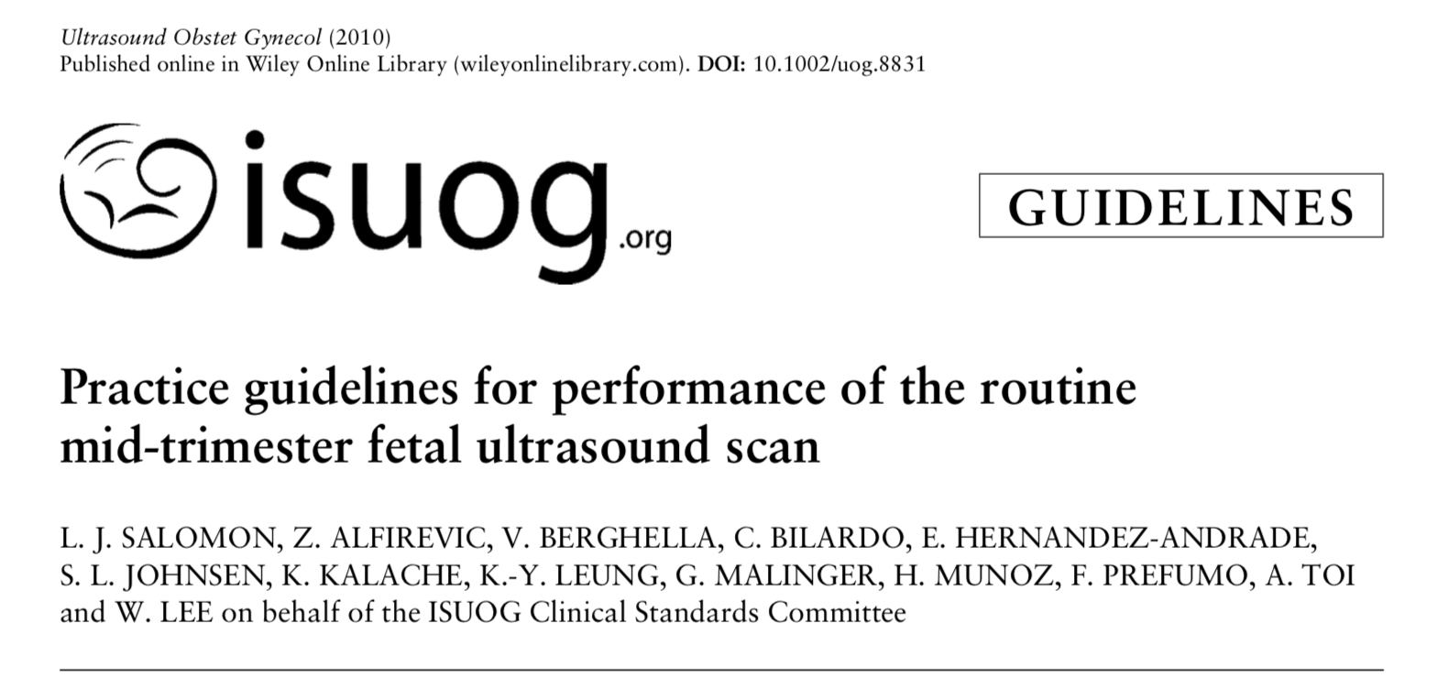
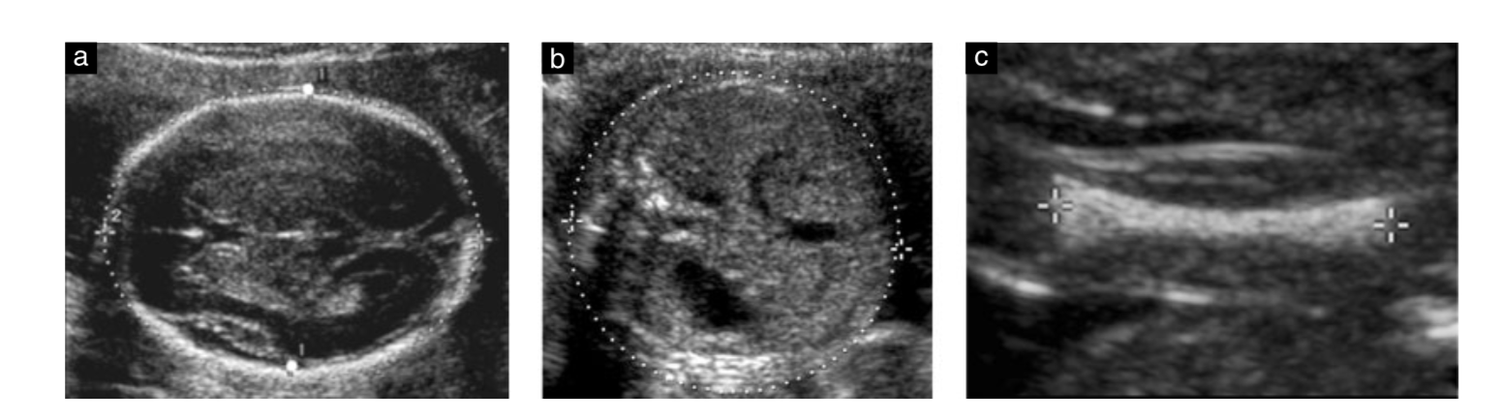
Fetal biometry by 2D sonography
AC alone
AC, HC
AC, HC, F
AC, HC, FL, BPD
Head circumference (HC)
Biparietal diameter (BPD)
Abdominal circumference (AC)
Femur length (FL)

Slide 3
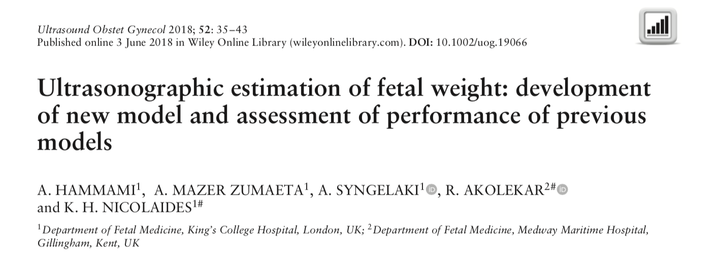
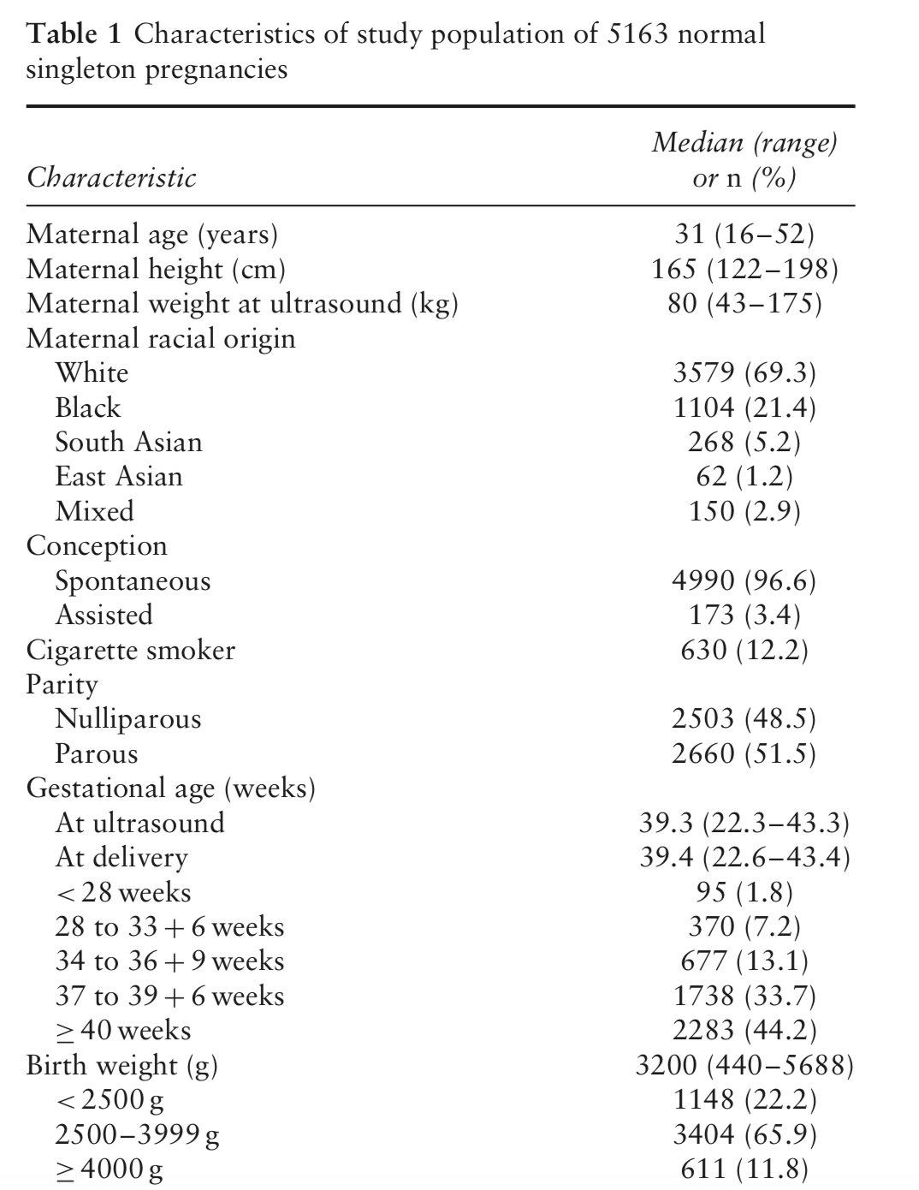
Development of new formula for EFW
5163 pregnancies
Fetal biometry at 22 – 43 weeks’ gestation
Within 2 days of delivery
Evaluate accuracy of 70 formulae (45 studies)
Notes:
MPE (mean % error) = 100 x ((EFW – BW)/BW)= systematic error
SDs of MPE and AE (measure of variation of prediction error & reflect precision of formula in calculating EFW
Ordinary straight line distance between 2 points in Euclidean space
Accuracy assessed by
Mean % error (MPE) = 100 x ((EFW – BW)/BW (systematic error)
Absolute mean error (AE) = absolute value of deviation of EFW from actual BW
SDs of MPE and AE (precision)
Proportion of pregnancies with AE </- 10%
Euclidean distance (√(MPE² + MPE SD²))
Accuracy evaluated in BW < 2500g and >4000g

Slide 4
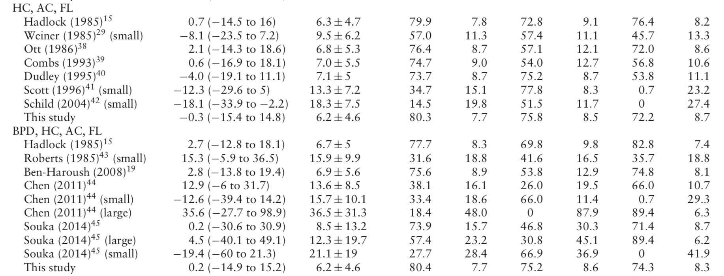
Most accurate model incorporates 3 parameters (head, AC and FL)
Large variation in accuracy→ Need for standardization
Most accurate model Hadlock et al. (HC, AC and FL)
MPE= mean % error; AE= absolute % error; SD= standard deviation; ED= Euclidean distance

Slide 5
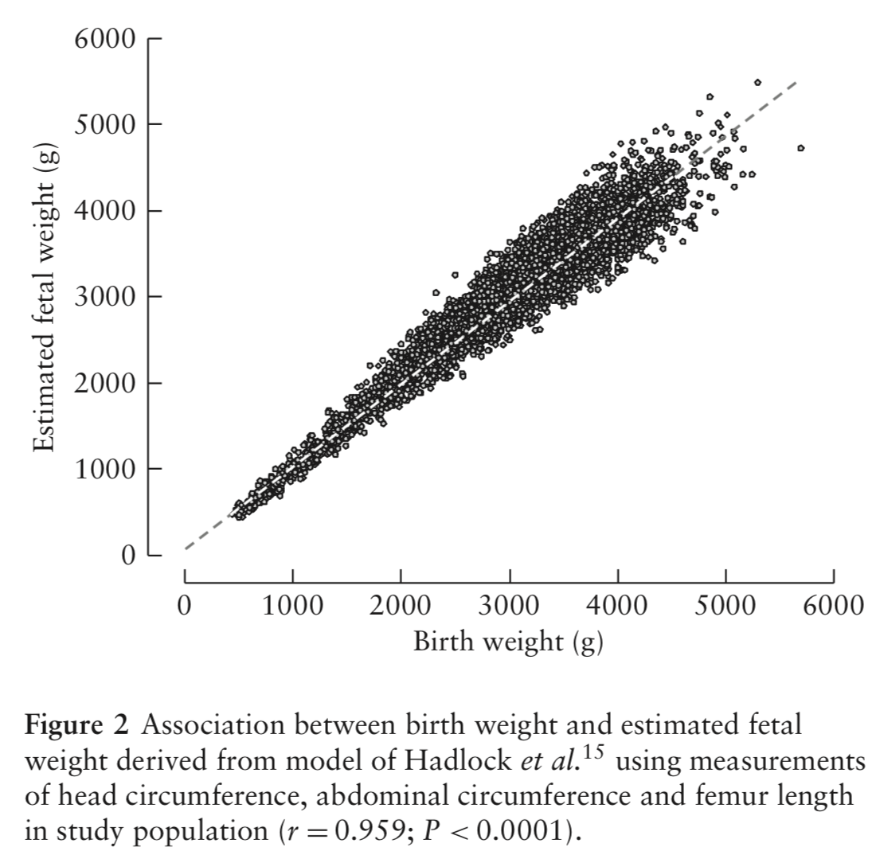
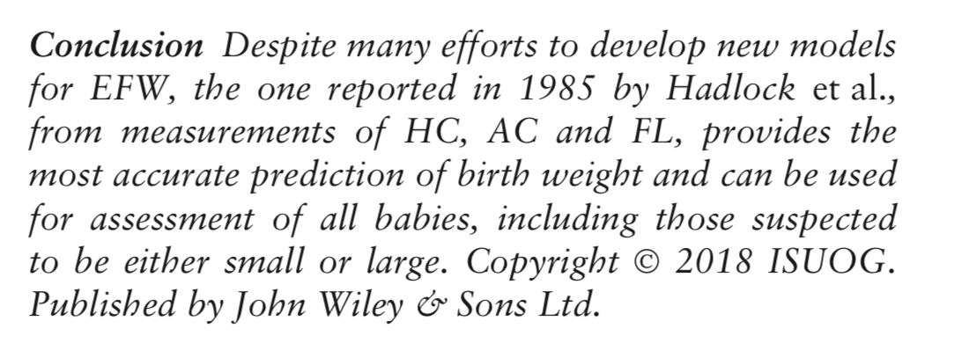
Most accurate model Hadlock et al. (HC, AC and FL +/- BPD)
EFW within 10% of BW in 80% of cases
BW <2500g: EFW within 10% of BW in 73% of small babies
BW ≥4000g: EFW within 10% of BW in 76% of large babies
Notes:
Highly significant linear association between BW and EFW derived by measurement of HC, AC and FL (r=0.959; p <0.0001)
Most accurate model Hadlock et al. (HC, AC and FL +/- BPD) based on 276 patients from 1985!
Large babies: Hadlock et al. BPD, AC and FL > HC, AC and FL

Slide 6
Conclusion: Fetal growth model for SOON

